Slide 1
Problem solving with computers
Computers use algorithmic solutions
Program – set of instructions that make up solution to a problem
Results – outcome of running the program
Testing – Are the outcomes what you expected and correct
Documentation –
  manual documentation – instructions telling users how to use the program

Slide 2
Problem solving with computers involves several steps
Clearly define the problem.
Analyse the problem and formulate a method to solve it (see also .validation.).
Describe the solution in the form of an algorithm.
Draw a flowchart of the algorithm.
Write the computer program.
Compile and run the program (debugging).
Test the program (debugging) (see also verification.).
Interpretation of results.

Slide 3
Problem solving concepts for computers
Constants
Variables
Operators
Hierarchy of operations
Data types
Equations
Functions
Expressions

Slide 4
Constant:
A variable whose value is determined when a program description is written and doesn’t change from that value during program execution.
A constant is a value in a program, that stays the same throughout the program's execution-numeric, alphabetical, special symbols. Ex:PI=3.142857
Rules:
Constant cannot be changed after it is initially given a value

Slide 5
Variable: a named location in memory for storing data.
Variables are values that can change as much as needed during the execution of a program. Ex:city=“chennai”

Slide 6
Rules:
Names... | Example
CANNOT start with a number | 2i
CAN contain a number elsewhere | h2o
CANNOT contain any arithmetic operators... | r*s+t
CANNOT contain any other punctuation marks... | #@x%£!!a
CAN contain or begin with an underscore | _height_
CANNOT be a C keyword | struct
CANNOT contain a space | im stupid
CAN be of mixed cases | XSquared

Slide 7

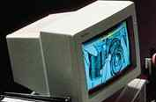

Data vs. Information
OUTPUT
INPUT
PROCESS
Information
Data
Unorganized facts
Processed meaningful report

Slide 8
DATATYPE
A type is the “kind” of data that variable is allowed to hold.

Slide 9
Data types and their data sets
Data type | Dataset | Examples
Numeric:integer | All whole numbers | 8765,-98
Numeric:Real | All real numbers(whole + decimal) | 3786.98,0.0087
Character(surrounded by quotation marks) | All letters, numerals and special symbols | “a”, ”A”, “=“,”5”, “$”
String(Surr. By quote marks) | Combinations of more than one character | “art”,”5678”,”01-345-456778”
Logical | True/false | True, False

Slide 10
Functions

Slide 11
Functions
Small sets of instructions that perform specific tasks and return values
Specify the basic tasks that are used repeatedly in the problem-solving process thus reducing time and improve the readability of the solution.
Function name(data)
Data used by the function are called parameters
Ex: sqrt(n), max(n1,n2,n3)

Slide 12
TYPES OF FUNCTIONS
Mathematical function: sqrt(n) , abs(n), sign(n)
String function: Left(S,n), right(S,n), Length(S)
Conversion function: String(N), Value(S)
Statistical function: Average(list), Max(list), Sum(list)
Utility function: Date, Time, Error

Slide 13
Operators

Slide 14
Operators
Operators are symbols that indicate some kind of action is to be performed.
Data connectors within expressions and equations
Tell the computer how to process the data
What type of processing needs to be done
OPERANDS- data that the operator connects and processes
RESULTANT-answer of the operation.

Slide 15
- Subtraction
+ Addition
* Multiplication
/ Division
% Modulus
-- Decrement
++ Increment
Power ^
3 – 2 =1
3 + 2 =5
3 * 2 =6
6 / 3 =2
3 % 2 =1
-- 2 =1
++ 2 =3
2 ^ 2 =4

Slide 16
Relational Operators
> Greater than
< Less than
>= Greater than or equal
<= Less than or equal
== Equal
!= Not Equal(<>)

Slide 17
Logical Operators
&& AND
A && B: result is true iff A and B are true, false otherwise
|| OR
A || B: result is false iff A and B are False, true otherwise
! NOT
NOT A: True if A is False

Slide 18
TRUTH TABLE
NOT
AND
A | Not A
T | F
F | T
A | B | A AND B
T | T | T
T | F | F
F | T | F
F | F | F
OR
A | B | A OR B
T | T | T
T | F | T
F | T | T
F | F | F

Slide 19
EXPRESSION:
An expression is a code segment that can be evaluated to produce a single value.
Processes the data, the operands through the use of operators.
ex:A + B
EQUATIONS:
stores the result of an expression in a memory location in the computer through the = sign. Ex:C=A + B

Slide 20
Hierarchy of operations
Functions
Power
\ , Mod
*, /
+,-
=,<,>,<=,>=.<>
NOT
AND
OR

Slide 21
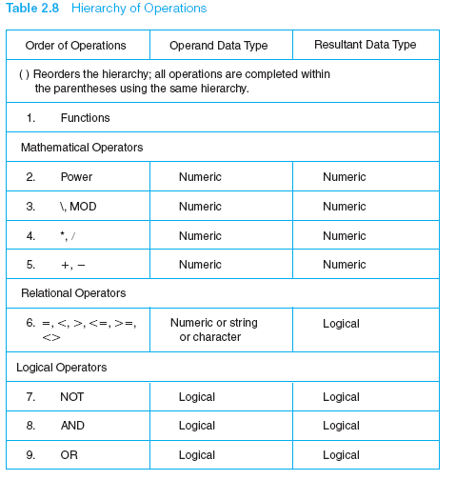

Slide 22
Evaluating Expressions
b
Calculate the area of the
following figure
x/2
x
x

Slide 23
Evaluating Expressions
x = 4 and b = 3
Area = x² + x/2 * b
4
4
1: x² (4² = 16 )
1
3
2: x/2 ( 4/2 = 2 )
3: Result of 2 * b
(2*3 = 6)
2
4: Result of 1 + Result of 3
(16 + 6 = 22)
16
2
3
4
6
22

Slide 24
Evaluating Expressions
Exercise :-
  5 + ( X + Y ) – 4 * Y / ( Z + 6 )
  X=2 Y=3 Z=6
  F = NOT ( A < B ) AND ( C OR D )
  A= 4 B=2 C=True D=False

Slide 25
Developing a Logical Expression

Slide 26
Developing a Logical Expression from a Given Problem
A large department store has its own charge card. The policy for a customer to charge an item is that the customer must have a valid charge card and either a balance of less than Rs.500 or a charge of less than Rs. 50.
Steps
  List the items and their data types.
    The charge card ( data type : logical)
    The balance ( data type : numeric)
    The charge amount ( data type : numeric )

Slide 27
A large department store has its own charge card. The policy for a customer to charge an item is that the customer must have a valid charge card and either a balance of less than Rs.500 or a charge of less than Rs. 50.
Steps
  Write down these items as variables along condition on each. Put them on one line, leave space between, so that logical operator can be added next.
  ChargeCard Balance 500 Amount 50
  The resultant or the data type of each expression must be logical.
  Remember that the operators must match the data types of the operands
  ChargeCard Balance < 500 Amount < 50
  Do not put logical operators yet.

Slide 28
A large department store has its own charge card. The policy for a customer to charge an item is that the customer must have a valid charge card and either a balance of less than Rs.500 or a charge of less than Rs. 50.
Steps
  Put logical operators and parentheses.
  ChargeCard AND ( Balance < 500 OR Amount < 50 )
  Because condition between Balance and Amount is one or other, so OR used.
  Condition between the charge card and the other two items is both, so AND used.
  Since, AND has precedence over OR, the parentheses are added around OR.

Slide 29
A large department store has its own charge card. The policy for a customer to charge an item is that the customer must have a valid charge card and either a balance of less than Rs.500 or a charge of less than Rs. 50.
Steps
  Created logical expression which can be used in various ways.
    In Assignment Statement
    OkToChg = ChargeCard AND ( Balance < 500 OR Amount < 50 )
    In a decision Statement
    If ChargeCard AND ( Balance < 500 OR Amount < 50 )
    Then Print “Ok to charge”
    Else Print “Not Ok to charge”

Slide 30
Exercise Problem
Set up a logical expression and decision expression for the following policy on using a company credit card. The card may be used if the
  Balance plus sales amount is less than the maximum allowed amount
  Last payment was less than 45 days ago
  Credit card has not expired.

